Slide 1
Web Forms and HTML
Lecture 3

Slide 2
Lists In Html
We can List out our items, subjects or menu in the form of a list. HTML gives you three different types of lists.
<ul> - An unordered list. This will list items using bullets.
<ol> - A ordered list. This will use different schemes of numbers to list your items.
<dl> - A definition list. This will arrange your items in the same way as they are arranged in a dictionary.
Unordered Lists:
An unordered list is a collection of related items that have no special order or sequence.
This list is created by using <ul> tag.
Each item in the list is marked with a butllet.
The bullet itself comes in three flavors:
squares,
discs,
circles.
The default bullet displayed by most web browsers is the traditional full disc.

Slide 3
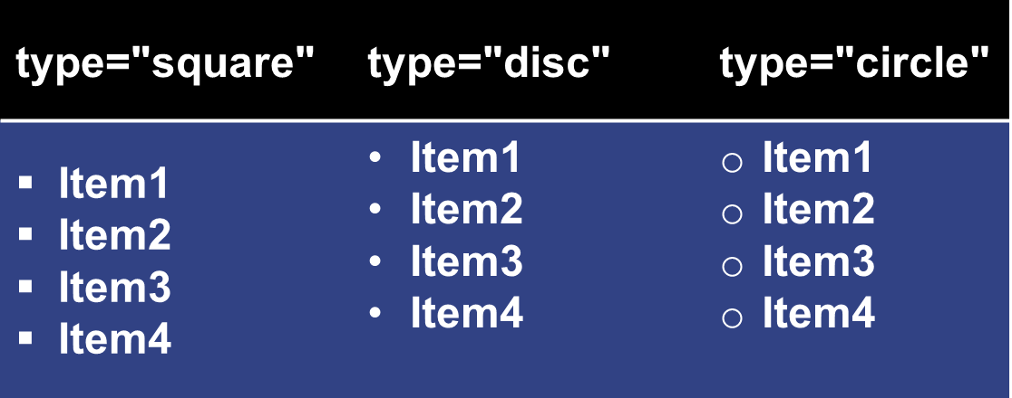
Lists In Html (contd.)
Example:
<ul type= “disc” >
<li>Item1</li>
<li>Item2</li>
<li>Item3</li>
<li>Item4</li>
</ul>
Ordered Lists:
There are 4 other types of ordered lists.
Instead of generic numbers you can replace them with Roman numberals or letters, both capital and lower-case.
Use the type attribute to change the numbering.
Start attribute is used for starting number as desired.
Example:
<ol type= “a” start="50" >
<li>Item1</li>
<li>Item2</li>
<li>Item3</li>
<li>Item4</li>
</ol>

Slide 4
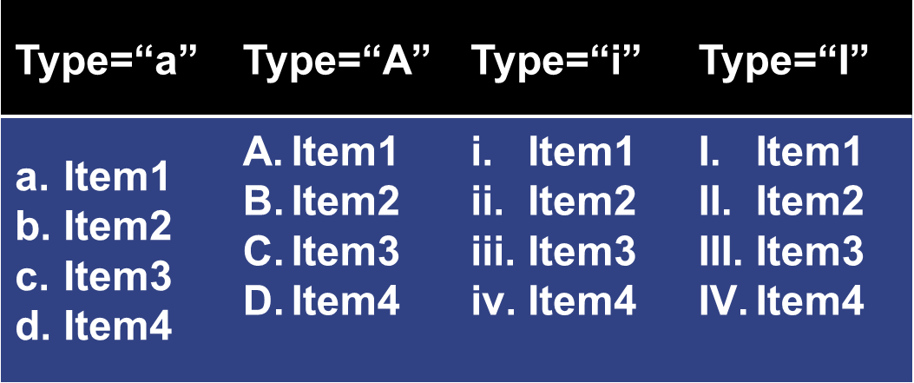
Lists In Html (contd.)
Definition Term Lists:
Make definition lists as seen in dictionaries using the <dl> tag.
These lists displace the term word just above the definition itself for a unique look.
It's wise to bold the terms to displace them further.
<dl> - defines the start of the list
<dt> - definition term
<dd> - defining definition

Slide 5
Lists In Html (contd.)
Example:
<dl>
<dt><b>Html</b></dt>
<dd>HyperText Mark Up Language</dd>
<dt><b>Xhtml</b></dt>
<dd>Xtensibile HyperText Mark Up Language </dd>
</dl>
Output:
Html
HyperText Mark Up Language.
Xhtml
Xtensibile HyperText Mark Up Language.

Slide 6
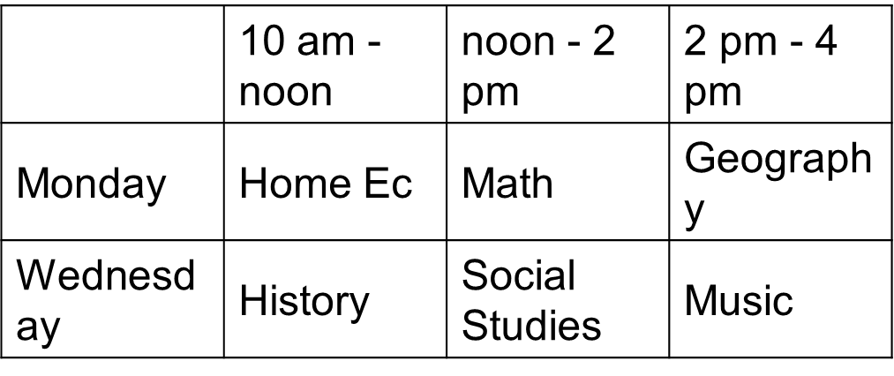
Tables In Html
Tables are just like spreadsheets and they are made up of
Rows
Columns.
Even though there is no longer any serious need to use tables for layout.
Tables be used for displaying tabular data—calendars, schedules, exam results, product pages.
You can create a table in HTML/XHTML by using <table> tag.
Inside <table> element the table is written out row by row.
A row is contained inside a <tr> tag . which stands for Table Row.
Each cell is then written inside the row element using a <td> tag . which stands for Table Data.
Table heading can be defined using <th> element. This tag will be put to replace <td> tag.
Normally we put our top row as table heading as shown below, otherwise you can use <th> element at any place:
Example:
<TABLE BORDER=2>
<TR>
<TD>&nbsp;</TD>
<TH>10 am - noon</TH>
<TH>noon - 2 pm</TH>
<TH>2 pm - 4 pm</TH>
</TR>
<TR>
<TH>Monday</TH>
<TD>Home Ec</TD>
<TD>Math</TD>
<TD>Geography</TD>
</TR>
<TR>
<TH>Wednesday</TH>
<TD>History</TD>
<TD>Social Studies</TD>
<TD>Music</TD>
</TR>
</TABLE>

Slide 7

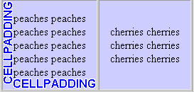
Tables In Html
Cell spacing:
CELLSPACING controls the space between table cells.
<table border="1" cellspacing="10“>
Cell Padding:
CELLPADDING sets the amount of space between the contents of the cell and the cell wall.
<table border="1" cellpadding="5" >

Slide 8
Tables In Html (Colspan & Rowspan)
Colspan:
colspan attribute used with <td> if you want to merge two or more columns into a single column.
Rowspan:
rowspan if you want to merge two or more rows.
For example:
We might want to create header cells for each Technology in our table of
id,
Name
Shift.
In this table, the header cells in the first and fifth rows span across two columns to indicate the Technology for each group of names.

Slide 9
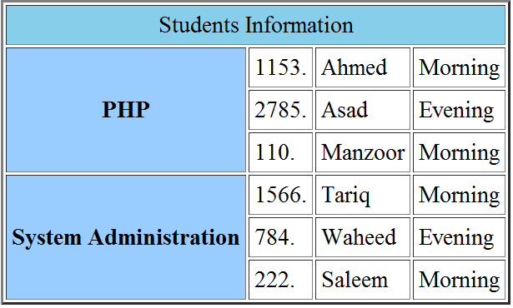
Example Table
<TABLE BORDER=2 CELLPADDING=4>
<TR>
<TD COLSPAN=4 BGCOLOR=“skyblue" align="center" >Students
Information </TD>
</TR>
<TR>
<TH ROWSPAN=3 BGCOLOR="#99CCFF">PHP</TH>
<TD>1153.</TD><TD>Ahmed</TD> <TD>Morning</TD>
</TR>
<TR>
<TD>2785.</TD><TD>Asad</TD> <TD>Evening</TD>
</TR>
<TR>
<TD>110.</TD><TD>Manzoor</TD> <TD>Morning</TD>
</TR>
<TR>
<TH ROWSPAN=3 BGCOLOR="#99CCFF">System Administration</TH>
<TD>1566.</TD><TD>Tariq</TD> <TD>Morning</TD>
</TR>
<TR>
<TD>784.</TD><TD>Waheed</TD> <TD>Evening</TD>
</TR>
<TR>
<TD>222.</TD><TD>Saleem</TD> <TD>Morning</TD>
</TR>
</TABLE>

Slide 10
Use Of Thead, Tfoot, Tbody
The advance structure of table be divided into three portions:
Head and Foot are similar to headers and footers in word processing.
The body is the main content of the table.
The three elements for separating the head, body, and foot of a table are:
<thead> - to create a separate table header.
<tbody> - to indicate the main body of the table.
<tfoot> - to create a separate table footer.
A table may contain several <tbody> elements to indicate different pages or groups of data.
But it is notable that <thead> tag should appear before <tbody> and <tfoot> tag should appear after <tbody>.

Slide 11
Example
<table border="1" width="100%">
<thead>
<tr>
<td colspan="4">This is the head of the table</td>
</tr>
</thead>
<tfoot>
<tr>
<td colspan="4">This is the foot of the table
</td>
</tr>
</tfoot>
<tbody>
<tr>
<td>Cell 1</td>
<td>Cell 2</td>
<td>Cell 3</td>
<td>Cell 4</td>
</tr>
<tr> ...more rows here containing four cells... </tr>
</tbody>
<tbody>
<tr>
<td>Cell 1</td>
<td>Cell 2</td>
<td>Cell 3</td>
<td>Cell 4</td>
</tr>
<tr> ...more rows here containing four cells... </tr>
</tbody>
</table>

Slide 12
Assignments
Practice Lists
  Create an unordered list
  Create an ordered list
  Use various bullet styles
  Created nested lists
  Create definition lists
Create Table structure as explained
Create Webpage Layout using tables

Slide 13
Questions?

